Slide 1
Warm-up
What is a polar bond?
Please take out your notes from Wednesday
SAES Due Feb 16th

Slide 2


Slide 3
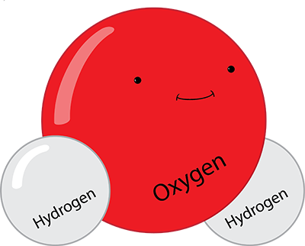
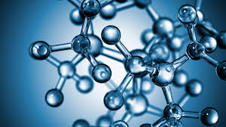
What is a Molecule
A molecule is a group of atoms held together by covalent bonds

Slide 4
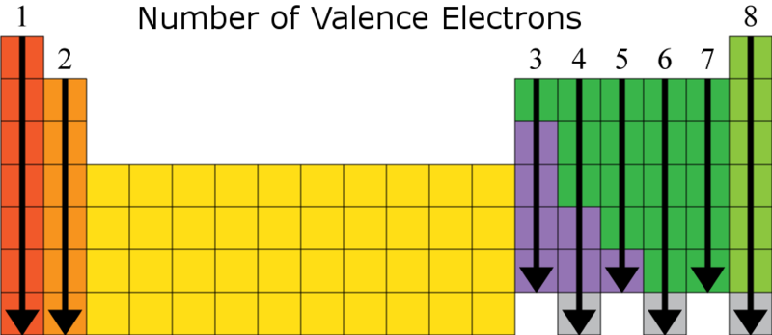
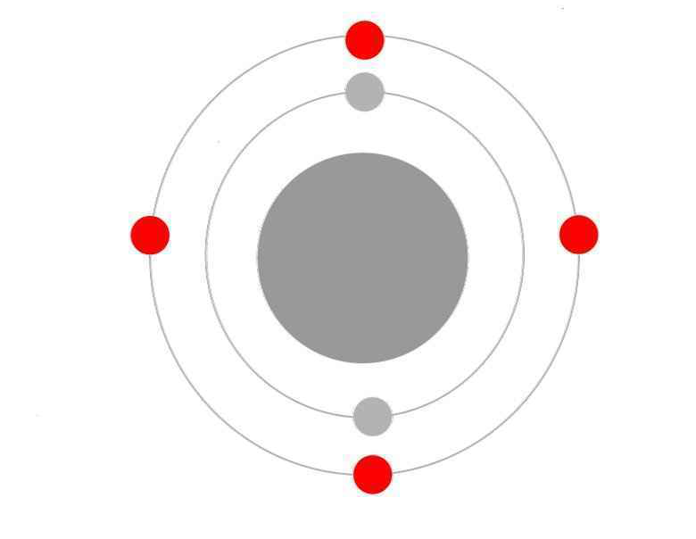
What are covalent bonds?
When two or more atoms share electrons
Why do atoms share electrons
  To complete their valence shell

Slide 5
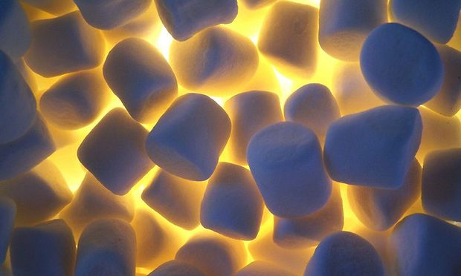
Covalent bond practice
If I have H2O, how would that molecule look?
    Why?
Marshmallow Molecules
Notes:
1.Students will receive marshmallows in 2 sizes, small and large and be provided with toothpicks
2. For each question on their worksheet they will be told what element each marshmallow represents.
3.They will then be asked to create the molecule using the rules of covalent bonds
4. After practicing and creating the molecule with their marshmallow they will draw the molecule on their worksheet

Slide 6

Marshmallow Molecules recap
Lets walk through what these answers are

Slide 7
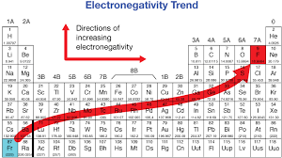
Polar bonds
Some atoms have a higher affinity for electrons than others (they want them more)
  This behavior is described as electronegativity

Slide 8
Polar bonds continued
A polar bond is created when an atom bonds with another atom with different electronegativities
Lets look at water
According to our trend which atom is more electronegative?
Does this create a charge like in an ion?

Slide 10
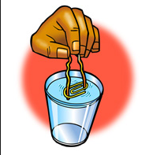
Can a paperclip float on water?
Fill up cup with water
Tear a piece of tissue paper about half the size of a dollar bill
GENTLY drop the tissue flat onto the surface of the water
GENTLY place a dry paper clip flat onto the tissue (try not to touch the water or the tissue)
Use the eraser end of the pencil to carefully poke the tissue (not the paper clip) until the tissue sinks.

Slide 11

Why can a paper clip float on water?
1. Why do you think the paper clip floated?
2. What types of bonds were present in the water?
3. Which is stronger, a covalent bond or a hydrogen bond?
Answer these three questions in pairs as I complete the notecheck, then we will recap as a class.
Make sure notes have at the minimum:
  What is a molecule?
  What is a covalent bond?
  What is electronegativity?
  What is a hydrogen bond?

